Slide 1
RNA-seq differential expression and pathway analysis
Prof. Dougu Nam
Dr. Bukyung Baik (TA)
UNIST
12th Oct 2023

Slide 2
Identifying differentially expressed genes (DEGs) : Multiple testing correction
Test
Control
DEGs
sort
Apply a significance cutoff
p-value
q-value (FDR)

Slide 3
How do we control false discovery rate (FDR or q-value)?
Bonferroni’s correction: p-value multiplied by the number of tests
Benjamini-Hochberg’s correction

Slide 4
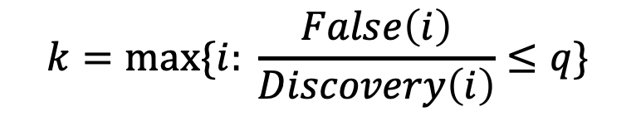
Benjamini-Hochberg procedure: (Linear step up procedure)
1
False
Discovery
Discovery: #significant feature
False: # null feature among discovery
t
0
1
2
k
m
Among our discoveries,
half are false!
$$k=max⁡\{i: \frac{False\left(i\right)}{Discovery\left(i\right)}≤q\}$$

Slide 5
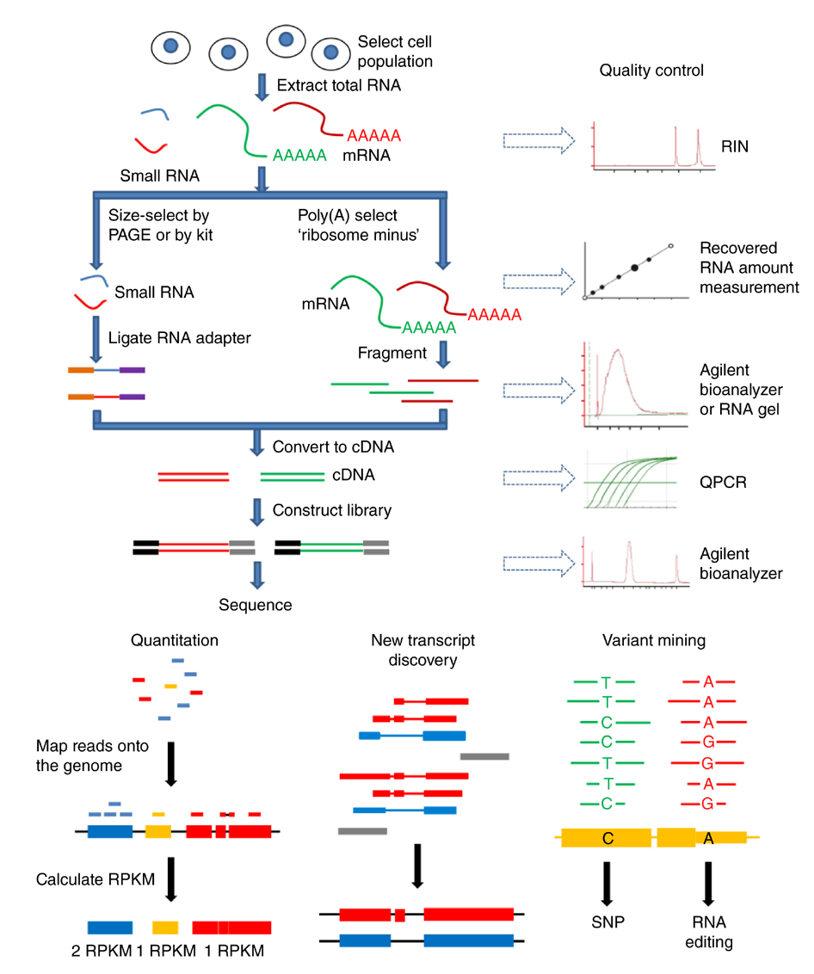
RNA-sequencing
Stable
ds DNA
Author: Ilaria Ferrarotto

Slide 6
Poisson model: Calculate the probability to observe k read counts
k events
Align the reads
Reference
sequence
Regard each gene as a unit interval
Regard the assigned reads as ‘events’
Probability
to observe k events
Single parameter: Mean=Variance=

Slide 7
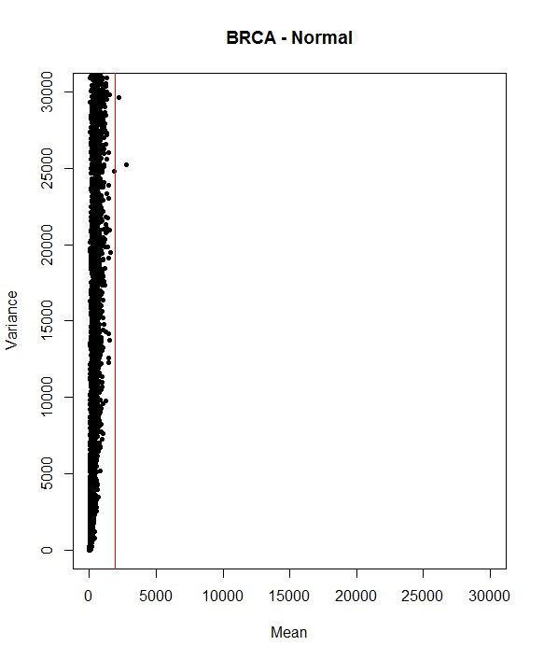
Do read counts have Poisson distribution?
Poisson model:
Mean = Variance
RNA-seq data:
Mean < Variance
A generalized Poisson (Negative binomial) distribution is used to model this situation
Expected
for Poisson
Mean vs. Variance:
Biological replicates

Slide 8
Negative binomial distribution: a generalized Poisson model
The composition of the Poisson and the gamma distribution,
dispersion
parameter
NB = Poisson
Alpha can be estimated using edgeR or DESeq2

Slide 9
Representative tools for RNA-seq differential expression (DE) analysis
R packages
DESeq2 (negative binomial model)
edgeR (negative binomial model)
limma (linear model, microarray & RNA-seq)
baySeq (negative binomial model)
PoissonSeq, DEGseq (Poisson model)
SAMseq (nonparametric methods)
CuffDiff (alternative splicing)

Slide 10
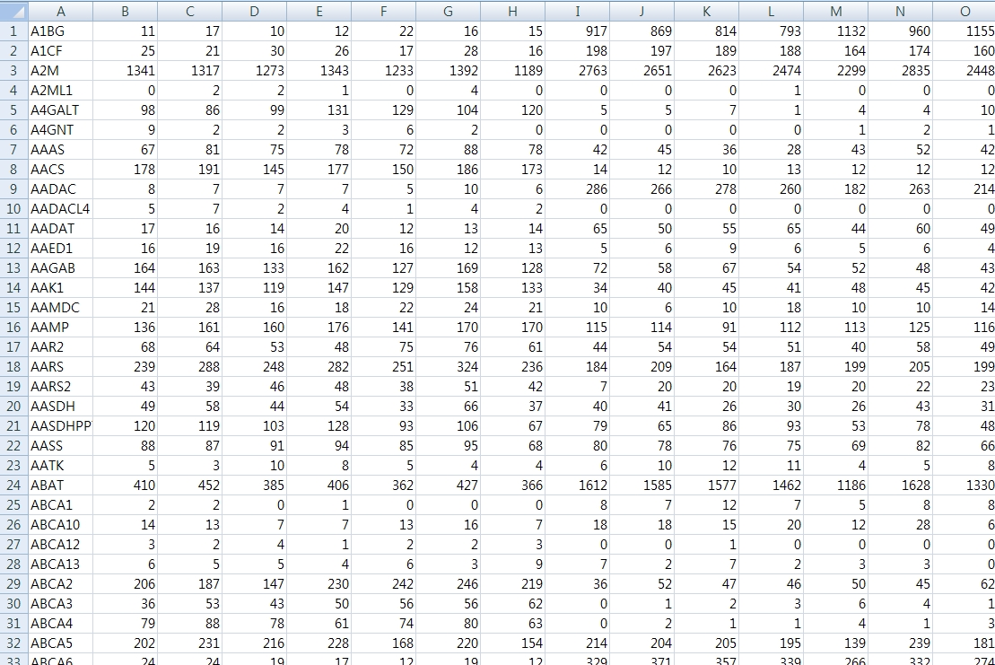





RNA-seq raw read count data
Test
Control
Library size or
Total read count
$$⋯$$
$$L_{1}$$
$$L_{2}$$
$$L_{3}$$
$$L_{M}$$

Slide 11
Why Normalization?
Different library size
Different RNA composition
100 reads
100 reads
#Reads
40 reads
40 reads
10 reads
10 reads
25 reads
25 reads
25 reads
25 reads
#Transcripts
g1
g2
g3
g4
g1
g2
g3
g4
Test sample
Control sample

Slide 12
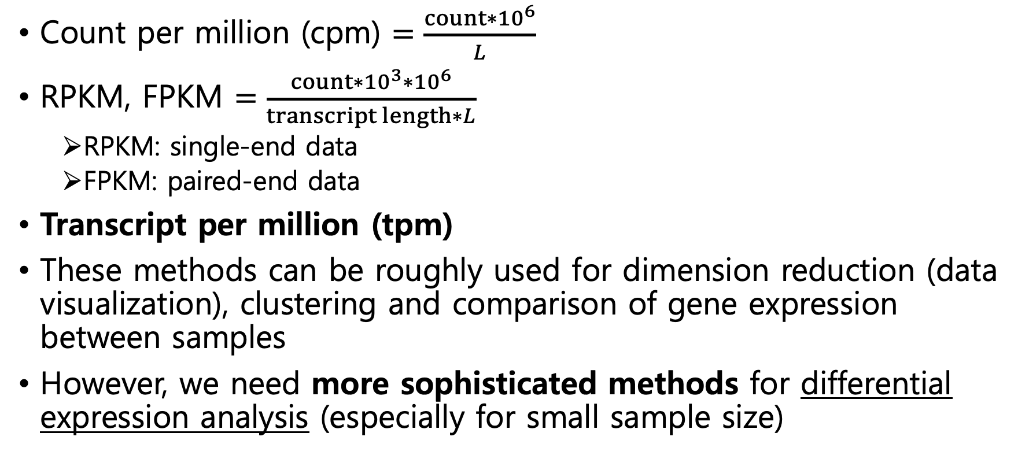
Simple normalization methods for RNA-seq data
Count per million (cpm) $=\frac{{count∗10}^{6}}{L}$
RPKM, FPKM $=\frac{{count∗{10}^{3}∗10}^{6}}{transcript length∗L}$
RPKM: single-end data
FPKM: paired-end data
Transcript per million (tpm)
These methods can be roughly used for dimension reduction (data visualization), clustering and comparison of gene expression between samples
However, we need more sophisticated methods for differential expression analysis (especially for small sample size)

Slide 13
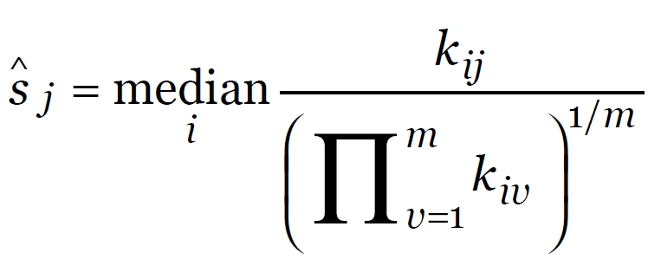
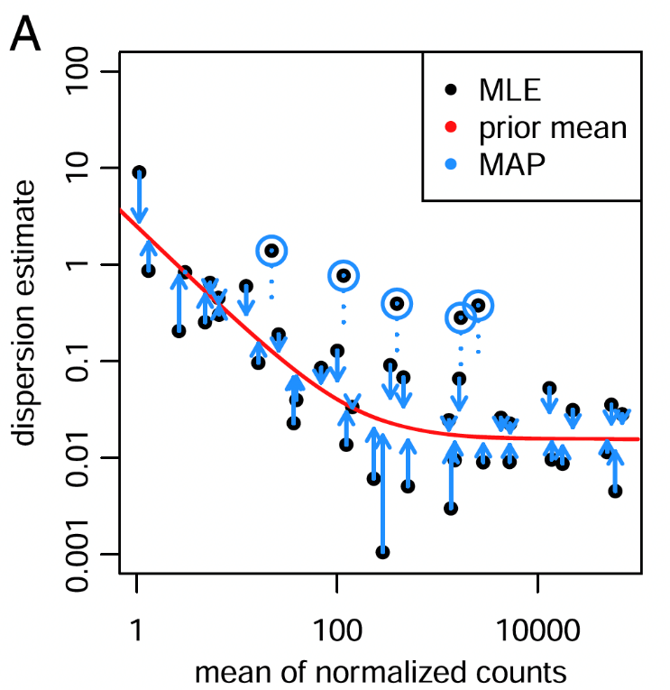
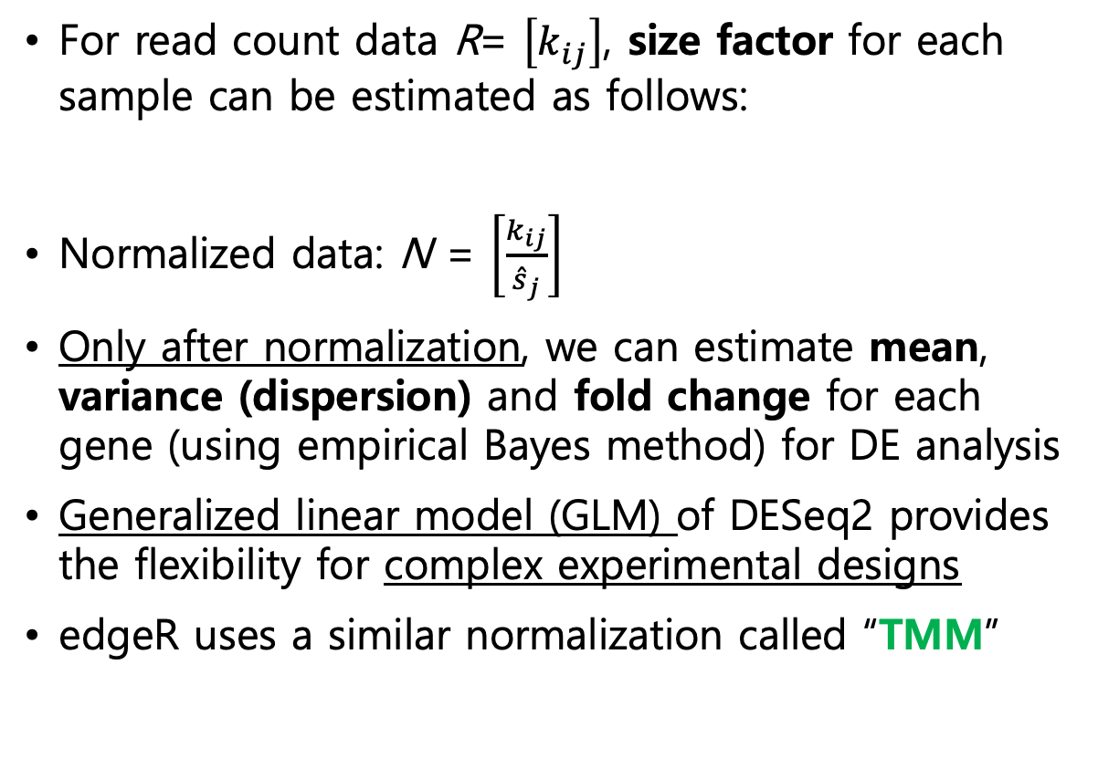
DESeq2 (Love et al., Genome Biology 2014)
For read count data R= $\left[k_{ij}\right]$, size factor for each sample can be estimated as follows:
Normalized data: N = $\left[\frac{k_{ij}}{{\hat{s}}_{j}}\right]$
Only after normalization, we can estimate mean, variance (dispersion) and fold change for each gene (using empirical Bayes method) for DE analysis
Generalized linear model (GLM) of DESeq2 provides the flexibility for complex experimental designs
edgeR uses a similar normalization called “TMM”
Simple & intuitive
normalization

Slide 14
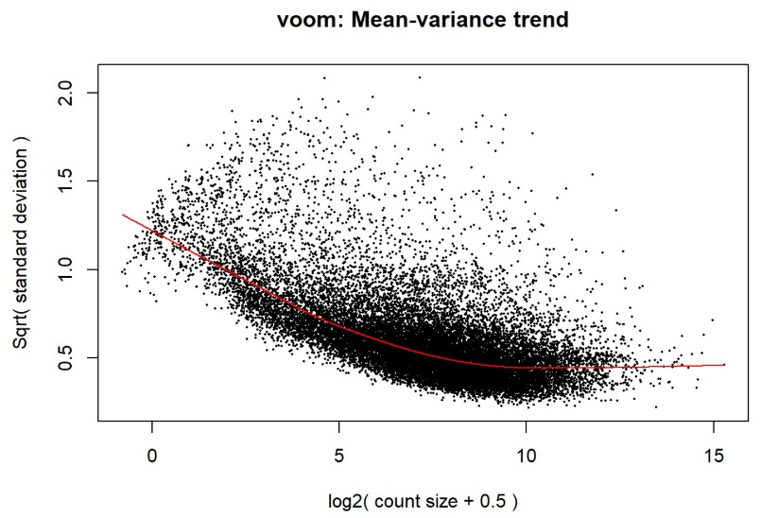
Limma (voom): linear modeling and differential expression analysis of microarray and RNA-seq (Ritchie et al., NAR 2015)
Widely used pipeline for differential analysis of microarray data
RNA-seq data are log-normalized (log-cpm) to be used for limma
(Bayesian) moderated t-test is used to perform differential expression analysis with observation weight (voom)
Generalized linear models are used to account for various experimental designs (e.g., multiple group comparison, batch effects, numerical covariates)
Estimates quality weight
for each count (voom)

Slide 15
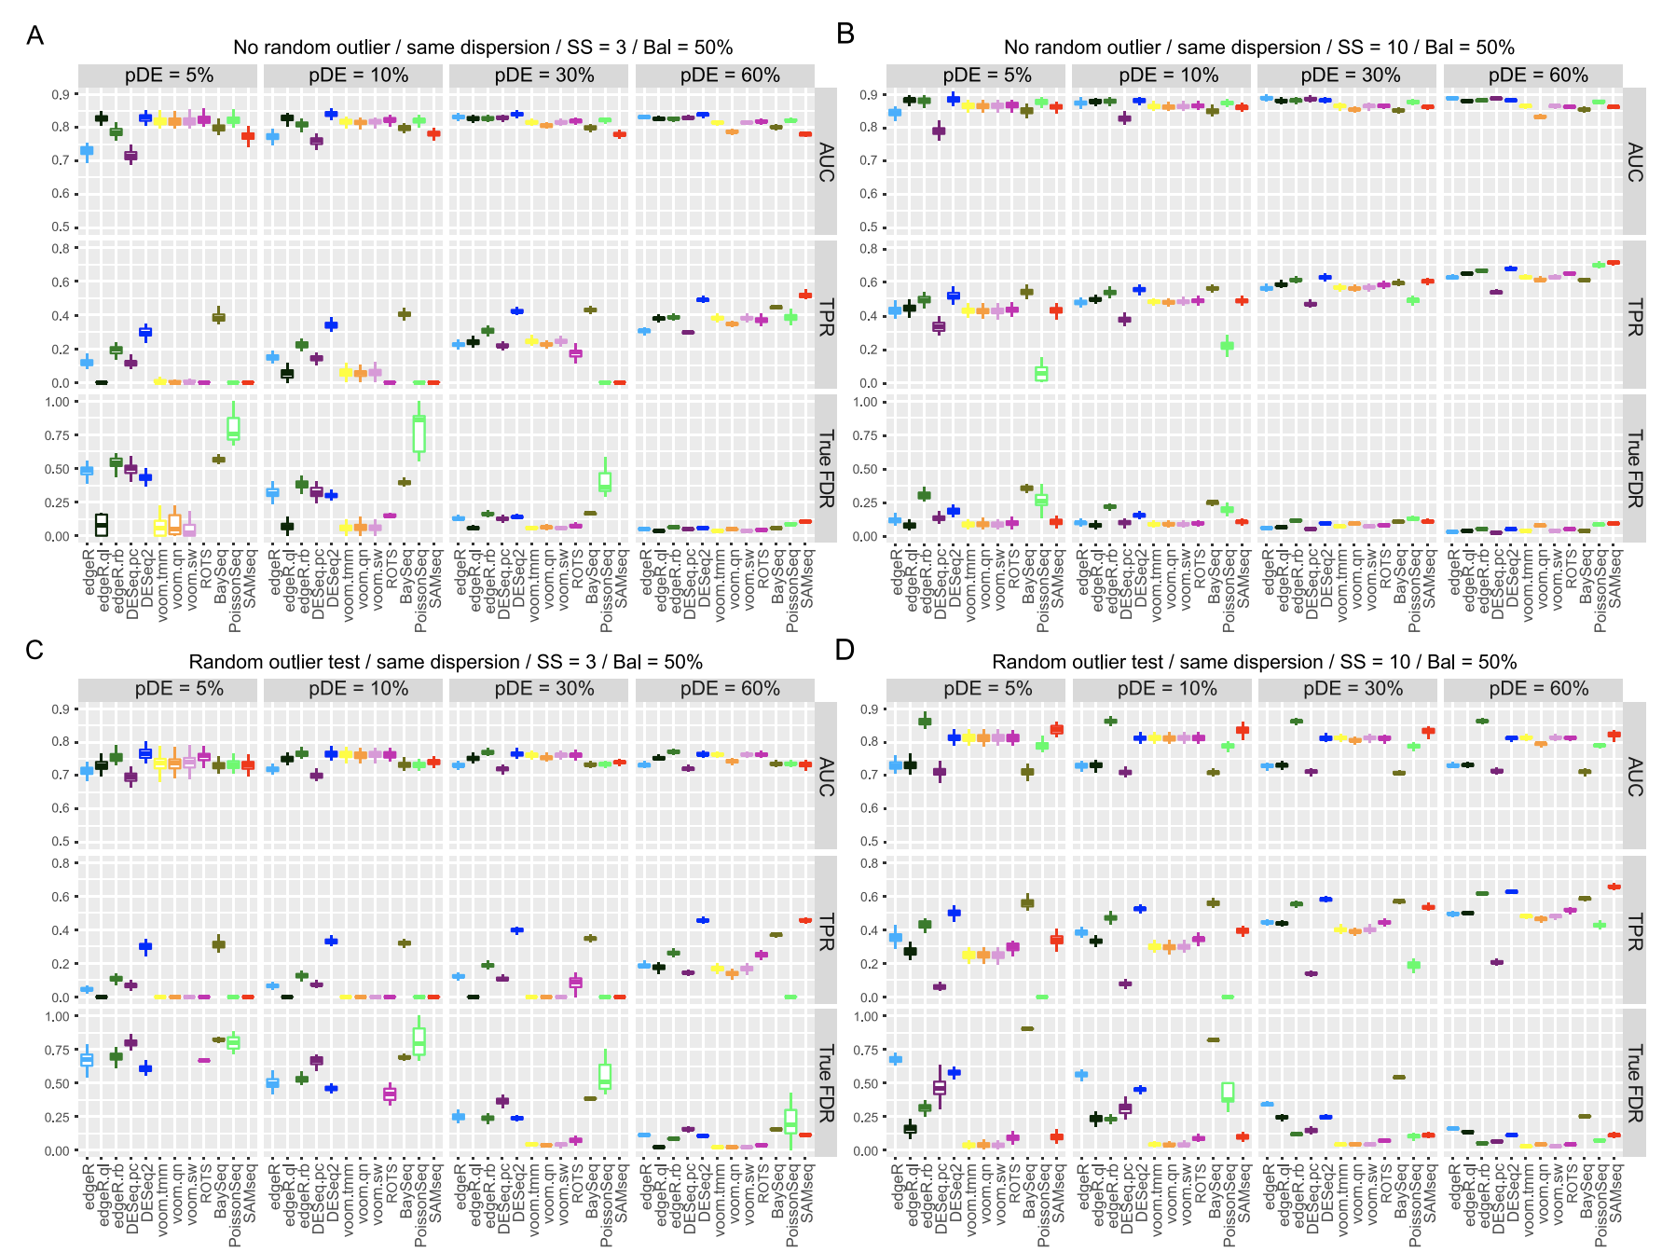
Benchmark in RNA-seq DE analysis (Baik et al. Plos One, 2016)
Simulation results

Slide 16
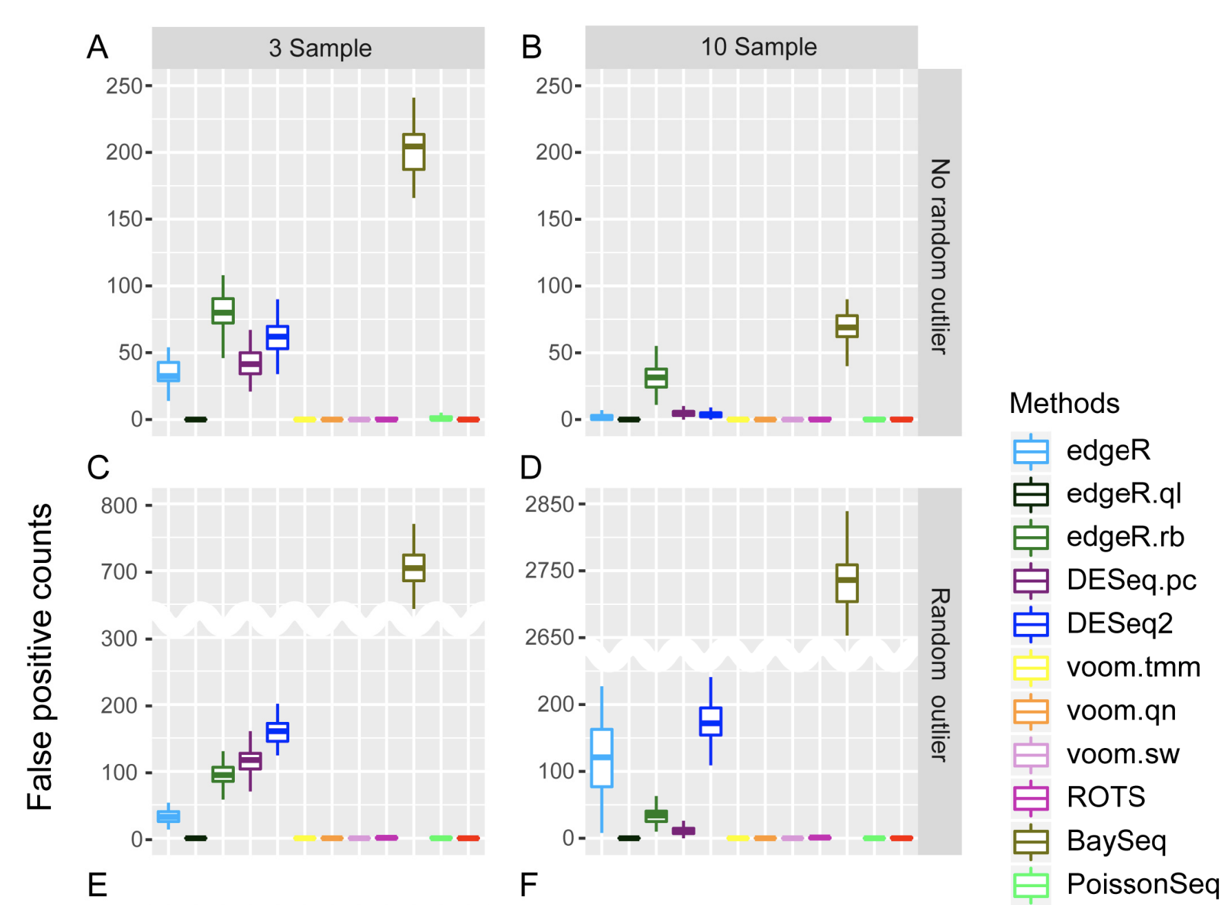
Comparison of false positive control

Slide 17
Recommended methods
DESeq2 performed the best in AUC and sensitivity, but it yielded a number of false positives for small sample size
edgeR.ql (quasi-likelihood) and limma-voom showed a good AUC and false positive control, but their sensitivities were very low
edgeR.rb (robust) performed the best when the data included a number of outlier counts

Slide 18
Covariates in DE analysis
Independent variables can affect the analysis considerably
Example: batch, age, sex, smoking, exercise, annual income, ethnical groups
Suppose a gene was significantly upregulated in test group compared to control group, but what if the test group included many heavy smokers? Can we still claim the upregulation of that gene?
We can include such “covariates” in our differential analyses
If our analysis included the covariates “age” and “smoking” for example, we can declare that “our analysis was adjusted for age and smoking”. This means the bias caused by those covariates were removed in our analysis, providing more reliable results

Slide 19
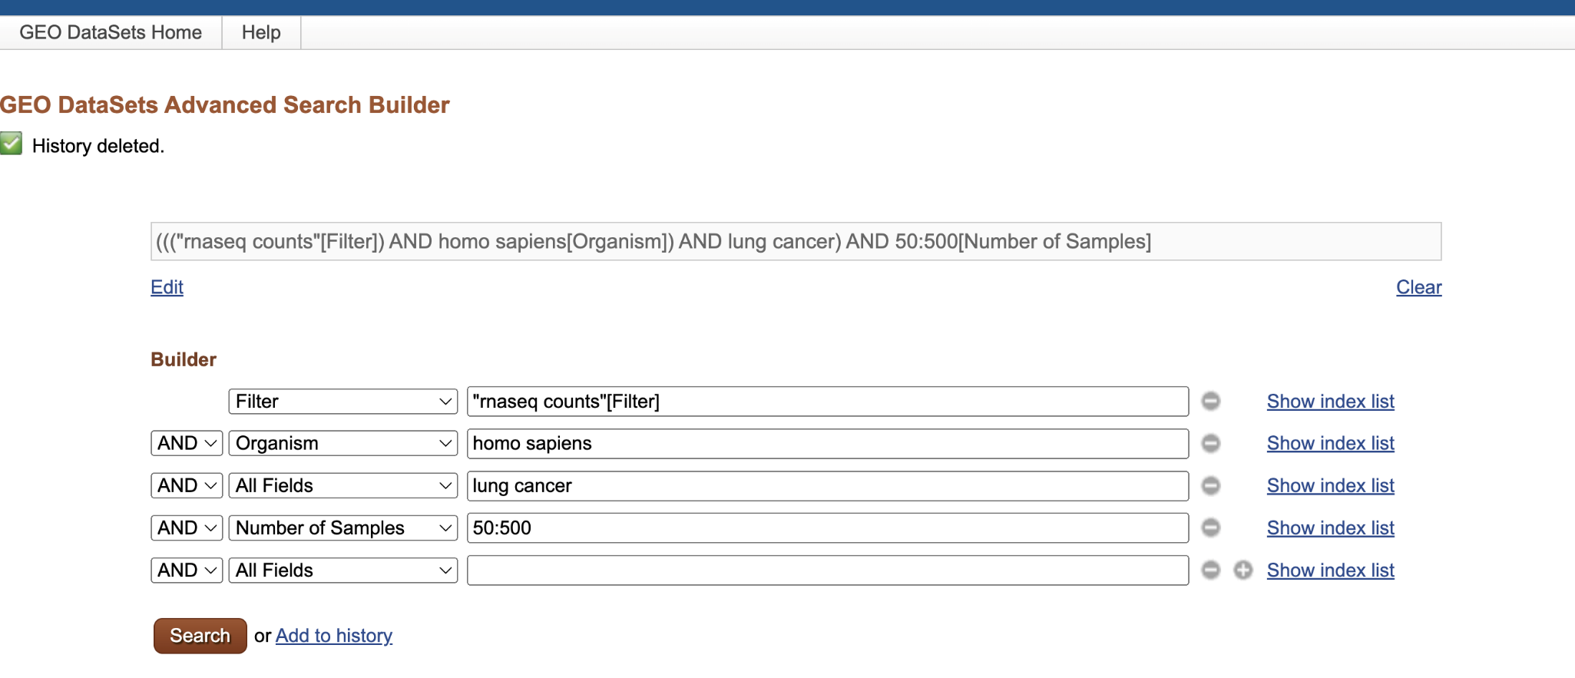
How to find RNA-seq count data from GEO database
https://www.ncbi.nlm.nih.gov/gds/advanced
"rnaseq counts"[Filter] 23,656 RNA-seq count data are available!! (Oct, 2023)
Exercise I: Let’s try DE analysis of RNA-seq data!!

Slide 20
How to interpret DEGs : Function enrichment (or pathway) analysis for gene list
Test
Control
The enrichment (overlap)
of each gene set
in the DEG list is assessed
DEGs
Hypergeometric
distribution
Biosynthesis
Apply a significance cutoff
DNA repair
Sort
Sporulation
Cell cycle
Swi4
Ace2
Mcm1…
Compile
biological
gene sets

Slide 21
Hypergeometric distribution (Toy example)
Total 1,000 genes
Target genes: DEG (e.g., 200 genes)
Sample: functional gene set (e.g., DNA repair 50 genes)
Overlap between target and sample: 30 genes
What is the significance of the overlap?
Total 1,000
Target
200
30
Sample
50

Slide 22
Hypergeometric distribution
How large is the observed overlap?
P-value: the probability that we observe 30 or more overlap
If the p-value<0.05, we interpret that many DNA repair related genes have expression changes
0
1
2
30
50
P-value ?

Slide 23
Gene sets are derived from gene (or protein) databases
Gene Ontology
KEGG
REACTOME
WikiPathway
Cis-acting regulatory motifs
Molecular signature database (MSigDB)
Biocarta and so on.

Slide 24
enrichR: function (pathway) analysis for gene list
Both web server (https://maayanlab.cloud/Enrichr/) and R package are available
218 gene-set libraries are provided
Graphical test results

Slide 25
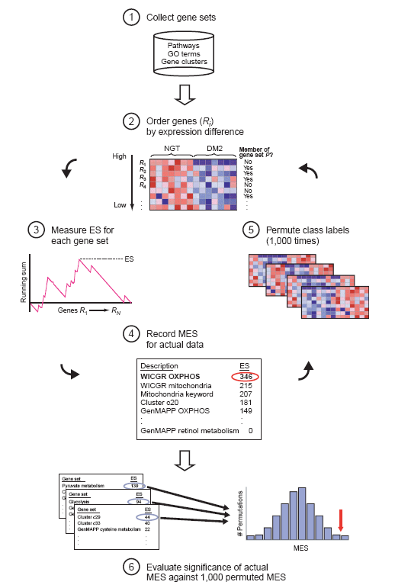
Gene Set Enrichment Analysis (GSEA)
Hybrid algorithm: gene randomizing score & sample permutation (Subramanian, PNAS 2005)
Cutoff-free enrichment analysis: all genes are used
This approach is able to capture “subtle but coordinated” gene-set expression changes

Slide 26
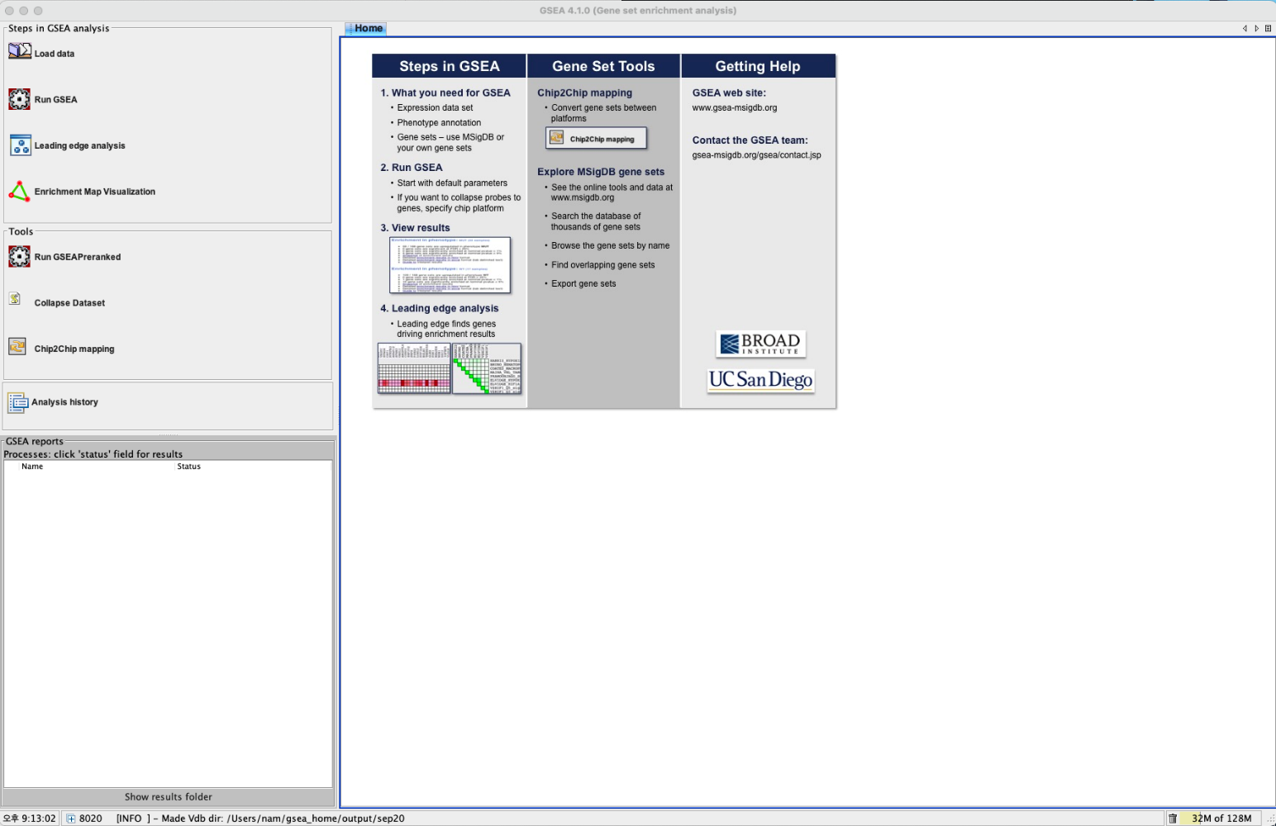
GSEA software
Freely downloadable from
https://www.gsea-msigdb.org/gsea/index.jsp

Slide 27
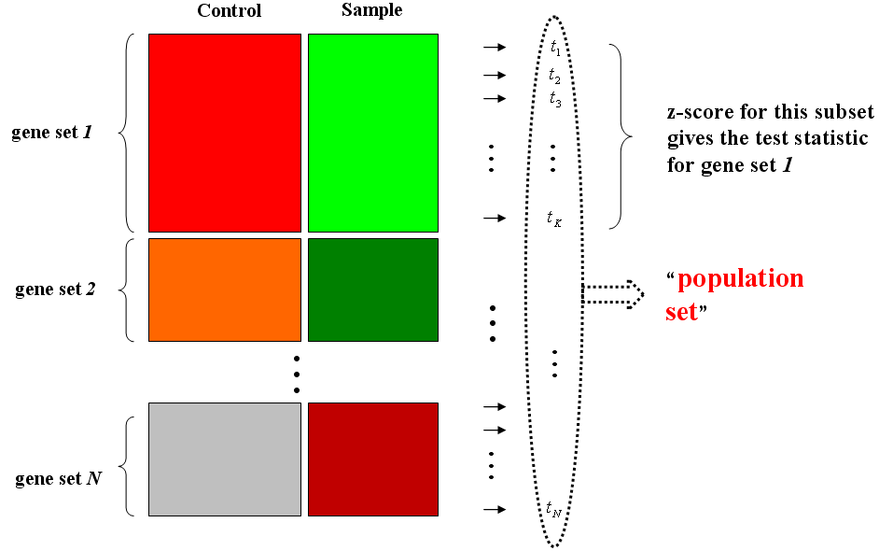
For small sample size→ Preranked GSEA
Gene-set
Rank score
Gene-set
score
Gene
Test
Control
Sample permutation &
Recalculate gene-set scores
Observed
gene-set
scores
Background
gene-set
scores

Slide 28
Input data for GSEA
Normalized gene expression data matrix (tpm, cpm, DESeq2)
Sample class information
Gene sets (directly browsed from GSEA software)
preranked GSEA: Two-column data for gene names and log(fold-change)

Slide 29
fgsea package
R package that Implements fast preranked GSEA
Quickly and accurately calculates arbitrarily low GSEA p-values for gene sets. See the preprint for algorithmic details.
https://bioconductor.org/packages/release/bioc/html/fgsea.html
How to use conventional GSEA software:
https://www.youtube.com/watch?v=KY6SS4vRchY
Exercise II: Let’s try enrichR and fgsea!!

Slide 30
Rsubread: R package for alignment and quantification of RNA-seq reads
﻿﻿Mapping/Alignment/Quantification on sequencing data using R
﻿﻿Comparable to other workflows in computing time and memory usage (e.g., STAR, TopHat2, etc).
﻿﻿Using R for end-to-end analysis
﻿﻿﻿﻿﻿﻿Bioconductor R package

Slide 31
Questions?
dougnam@units.ac.kr

